Slide 1
Buying New Energy Efficient Equipment
The Energy Technology List (ETL)

Slide 2
Introduction
This presentation provides information about the Energy Technology List (ETL) for procurement of new energy saving equipment.
The presentation is divided into sections that answer the following questions:
What are the benefits of purchasing energy efficient equipment?
What is the Energy Technology List?
Who uses the ETL, how do they use it, and why do they use it?
Additional information

Slide 3
1
What are the benefits of purchasing energy efficient equipment ?

Slide 4
What are the benefits of purchasing energy efficient equipment?
Energy efficiency is one of the most cost-effective ways to decrease energy use
and greenhouse gas emissions.
When making purchasing decisions, organisations frequently focus on the purchase price of new equipment when in reality the running costs, such as the cost of energy, can very quickly outweigh the value of the initial purchase price.
Energy saving equipment can result in:
lower energy bills;
reduced greenhouse gas emissions; and
quicker payback of the cost of purchase, through reduced operational costs.
Improving energy efficiency is one of a variety of measures that organisations can take to improve their environmental credentials.

Slide 5
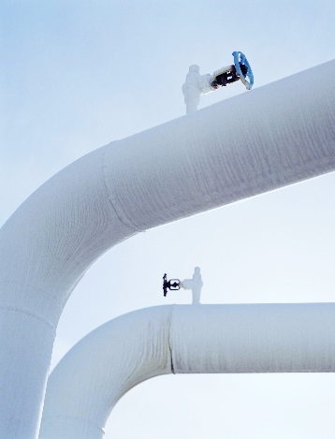
2
What is the Energy Technology List?
How can it help me procure equipment?
What kinds of equipment are listed?
How does equipment qualify for the list?

Slide 6
What is the Energy Technology List (ETL)?
The ETL is a government approved list of energy efficient equipment across a wide range of technology categories.
Currently, over 8,000 products across 62 technology areas are listed on the ETL.
Using the ETL can help organisations navigate product selection and have confidence about energy efficiency claims: Despite the benefits of energy efficiency, organisations may find it difficult to know if the equipment they have selected actually performs better than other options. The ETL rigorously evaluates listed products so that businesses can have confidence in their energy performance.
The ETL can be used to streamline purchasing decisions, ensuring that efficient options are selected to decrease energy bills and increase green credentials.
Please note that on 29 October 2018, the Chancellor announced that the ECA and First Year Tax Credits Scheme (FYTC) will end from April 2020.

Slide 7
What technologies are listed on the ETL?
Equipment that is eligible:
Listed on the ETL
Complies with ETL criteria and the manufacturer has provided a statement of compliance (ETL “unlisted” categories)
Assessed CHP equipment that has received a certificate of energy efficiency
Equipment listed on the ETL
Unlisted ETL categories:
Boiler equipment
Boiler retrofit equipment
Compressed air equipment
Heat pumps
Heat recovery ventilation units
Heating, ventilation and air conditioning (HVAC) equipment
Hand air dryers
Motors, drives and fans
Pipework insulation
Portable energy monitoring equipment
Radiant and warm air heaters
Refrigeration equipment
Solar thermal collectors
Uninterruptible power supplies
Waste Heat to electricity conversion equipment
Wastewater heat recovery systems
Automatic Monitoring and Targeting Systems
Lighting equipment
Air to Air Heat Pumps, Split, Multi-Split and VRF
Combined Heat and Power (CHP)
For more information please visit the CHPQA webpage.

Slide 8
What does it mean to qualify for the ETL?
The energy saving criteria are set to ensure eligible products represent a significant improvement in energy performance over current standard products.
The ETL seeks to incentivise the use of energy efficient products. In so doing, the ETL aspires to encourage manufacturers to design more products that qualify as highly energy efficient equipment.
In contrast, Minimum Energy Performance Standards, such as building design regulations and EcoDesign, are used to remove the poorest performing equipment from the market.
As the market evolves and equipment energy performance generally improves for a technology, the list requirements will change to make sure that only the highest energy efficient equipment is represented.
Bottom 25%
Top 25%
ETL Products
Average Performance
High Energy Efficiency Performance
Minimum Energy Efficiency Performance

Slide 9
How are products on the ETL assessed?
The ETL has established robust energy efficiency criteria for each listed and “unlisted” technology against which products are assessed
The ETL independent technical team review the products against the criteria to demonstrate that the products meet the established requirements
Different Performance requirements are set for each technology
For most categories manufacturers need to test their equipment performance to BS EN standards
All products must be tested in accordance with the relevant procedures and test conditions
To see specific requirements for the technology categories, please visit The ETL Criteria List
Where products are assessed as meeting the criteria, they are added to the ETL. If they do not meet the criteria (which may be due to a lack of supporting information in the application) then the products are not added.

Slide 10
Additional information about unlisted technology categories
As described in slide 7, some technologies are part of the ETL, but are “unlisted” technology categories. For some technologies it is not practical to list all qualified products. Nonetheless, unlisted technology categories that are part of the ETL.
Unlisted technology categories include: air to air heat pumps, split, multi-split and VRF.
For unlisted categories a supplier can use the technology criteria to determine if a specific product qualifies
There is a different process altogether for CHP equipment
Useful sources of information for unlisted technologies:
Factsheet
https://etl.beis.gov.uk/system/guides/key-information-purchasers-factsheet

Slide 11
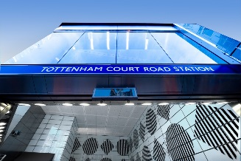
London Underground
Technologies: Across the Tube network in the past two years lighting and VRF systems have been installed at a number of stations, and variable speed drives within cooling systems and escalators. Upgrades at stations such as Victoria, Liverpool Street and Moorgate include many ETL-listed assets.
London Underground’s Procurement Process: LU has included project management processes to ensure delivery teams are using the ETL. The energy efficiency requirements in LU’s engineering standards for electrical and mechanical equipment have been aligned to the performance criteria of the ETL and LU is encouraging its suppliers to make sure their products are listed.

Slide 12
3
Who uses the ETL, how do they use it, and why do they use it?
A case study

Slide 13
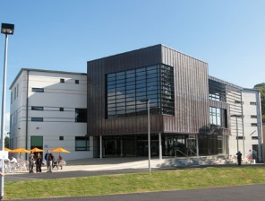
University of Reading
Technologies: the University has used the Energy Technology List across a range of different technologies, from boilers to refrigeration units to high-efficiency hand dryers.
How the university used the ETL: The University of Reading has used the Energy Technology List to select projects and deliver energy efficiency savings across the University. For example, the University recently installed 72 high-efficiency hand dryers, selected directly from products listed on the Energy Technology List.
Financial savings: These products have delivered attractive financial paybacks in terms of the energy saved. It is estimated that the 72 dryers are delivering total energy savings of £8,022 annually – calculated using Salix Finance’s hand dryer calculation tool.

Slide 14
4
Additional information

Slide 15
Where can I find more information?
For information about the ETL or to search for a product please visit: https://etl.beis.gov.uk/
Or contact the ETL Help Line on +44 20 3096 4800 or email info@etl.beis.gov.uk.

